Slide 1
虛擬化技術 Virtualization Techniques
Network Virtualization
Introduction

Slide 2
Agenda
Introduction
External network virtualization
What to be virtualized
Network device virtualization
Network data path virtualization
How to be virtualized
Protocol approach
Internal network virtualization
KVM approach
Xen approach
Case study

Slide 3
Network virtualization
Introduction
External network virtualization
Internal network virtualization

Slide 4
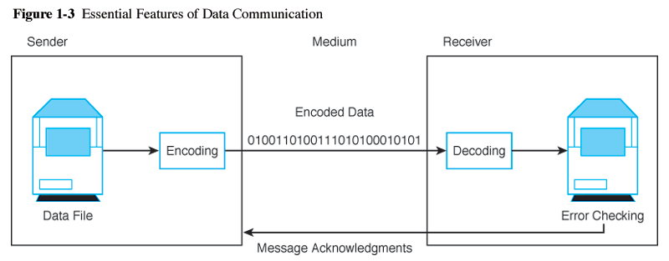
Introduction
What is computer network ?
A computer network, often simply referred to as a network, is a collection of computers and devices interconnected by communications channels that facilitate communications among users and allows users to share resources.
Why should we study network ?
Computer networks are used for communication and coordination, as well as commerce by large as well as small organizations.
Computer networks and the Internet is a vital part of business infrastructure.

Slide 5
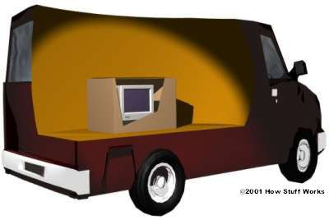
Network Protocol and Model
Network protocol
Rules and procedures governing transmission between computers
Used to identify communicating devices, secure attention of intended recipient, check for errors and re-transmissions
All computers using a protocol have to agree on how to code/decode the message, how to identify errors, and steps to take when there are errors or missed communications
Computer System Protocol
Delivery Protocol
Packaging Protocol

Slide 6
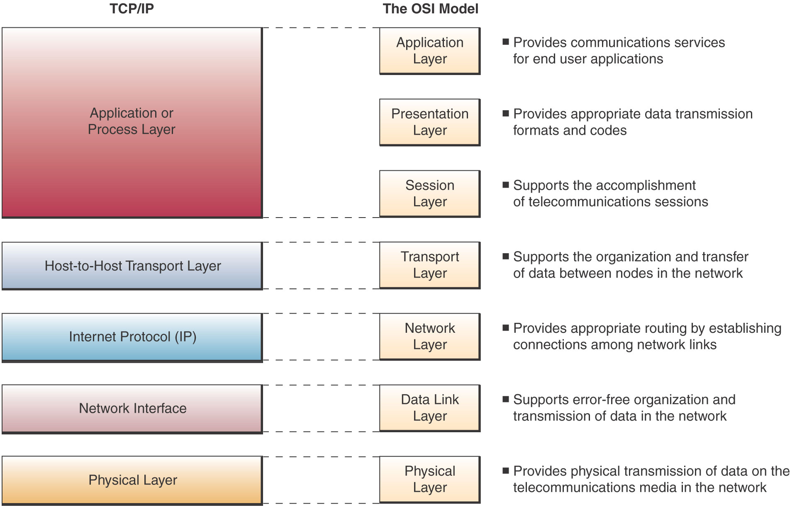
Network Protocol and Model

Slide 7
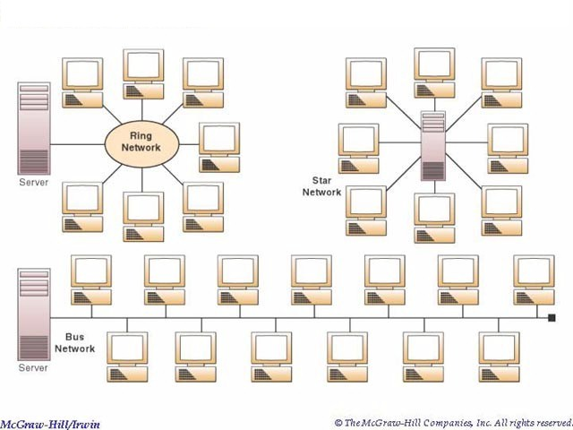
Network Topologies
Topologies
Topology refers to the physical or logical layout of the computers in a particular network.
Commonly used topologies are star, bus and ring.

Slide 8
Network Types
LANs and WANs
Local area network
Network of computers and other devices within a limited distance
Use star, bus or ring topologies
Network interface cards in each device specifies transmission rate, message structure, and topology
Network operating system routes and manages communications and coordinates network resources
Wide area network
Network of computers spanning broad geographical distances
Switched or dedicated lines
Firms use commercial WANs for communication

Slide 9
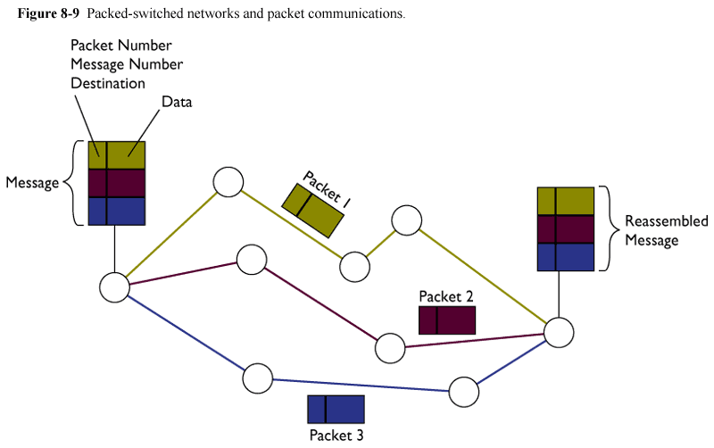
Network Architecture
Packet switching
Message/Data is divided into fixed or variable length packets
Each packet is numbered and sent along different paths to the destination
Packets are assembled at the destination
Useful for continued message transmission even when part of the network path is broken

Slide 10
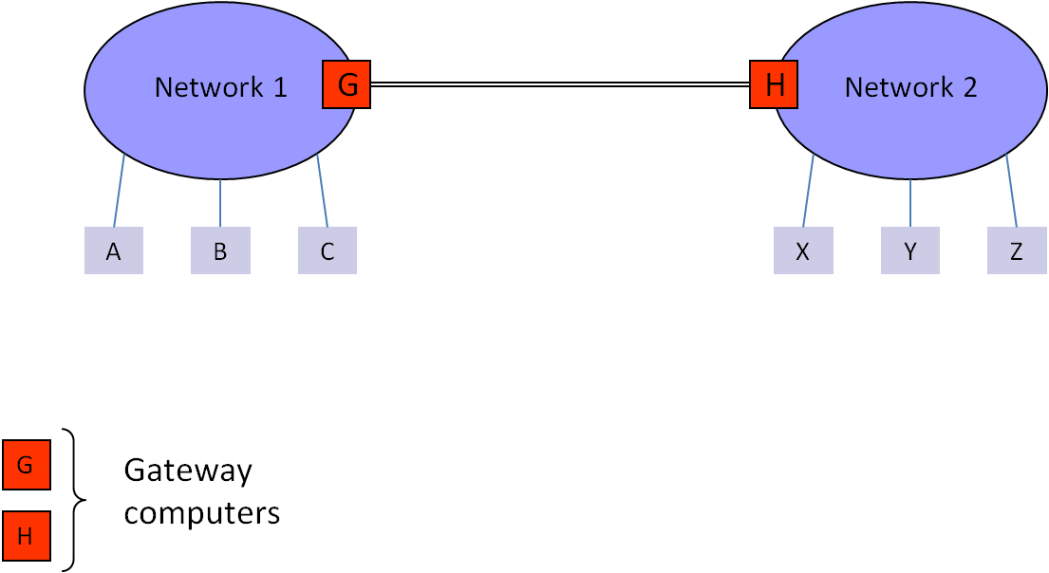
Network Architecture
Connect two networks

Slide 11
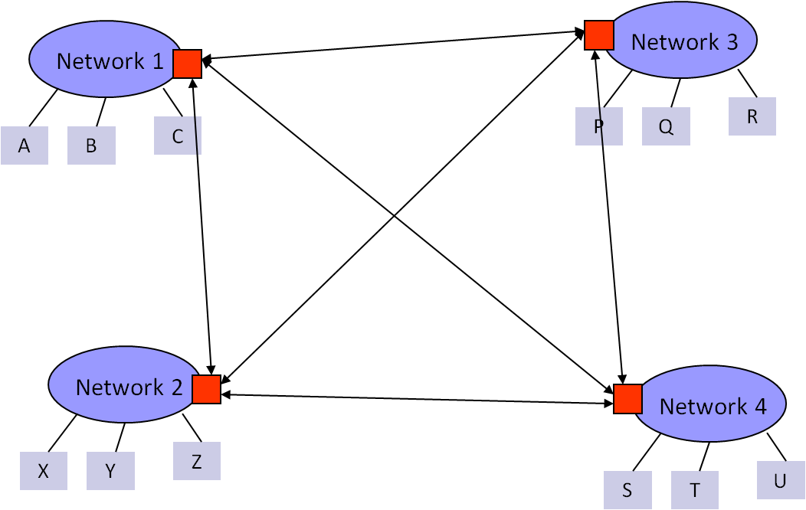
Network Architecture
Connect multiple networks

Slide 12
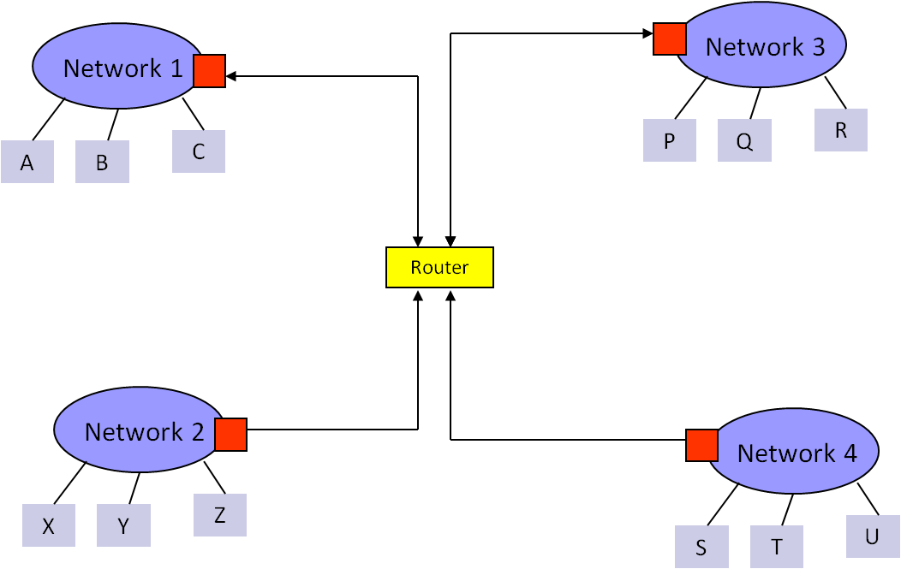
Network Architecture
Connect multiple networks

Slide 13
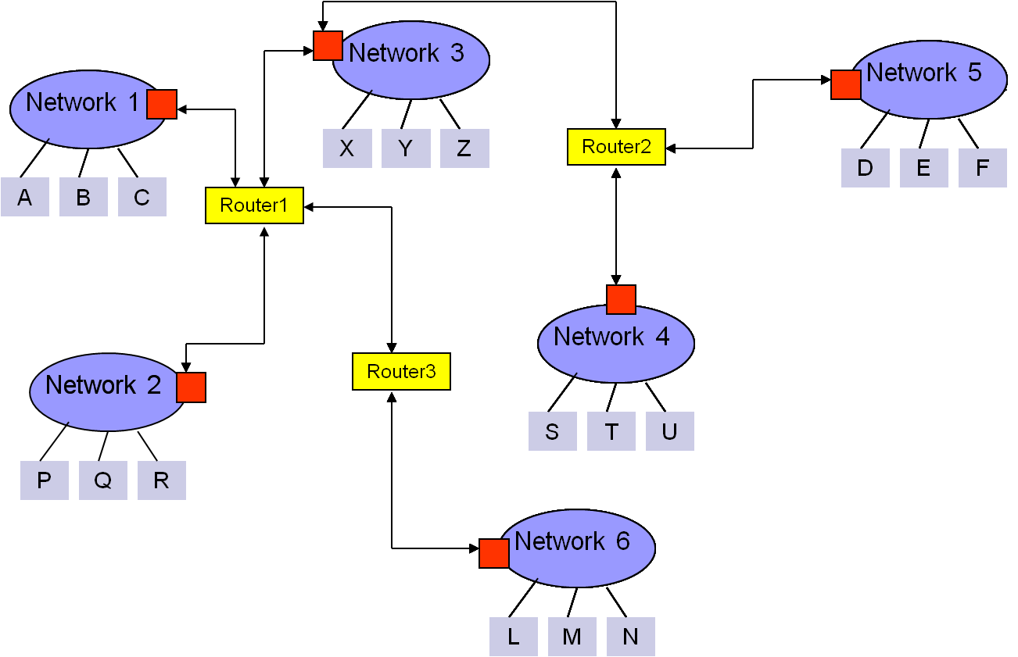
Network Architecture
Connect multiple networks

Slide 14
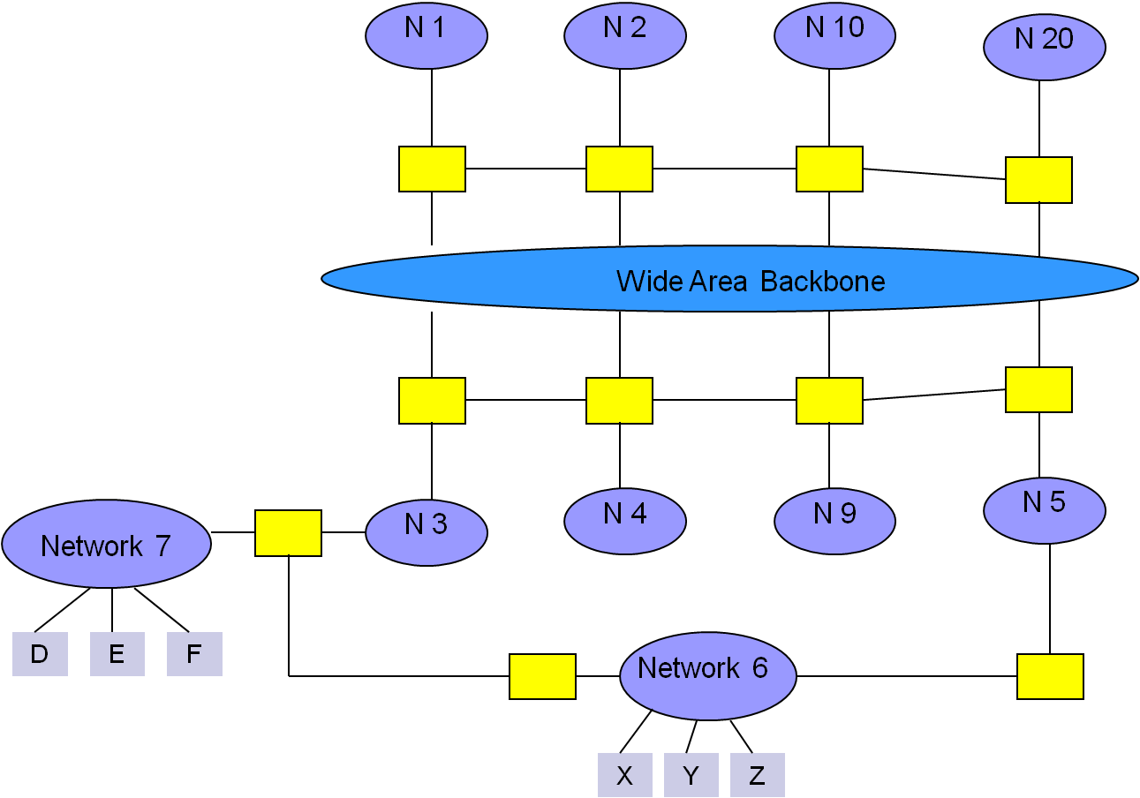
Network Architecture
The simple view of Internet

Slide 15
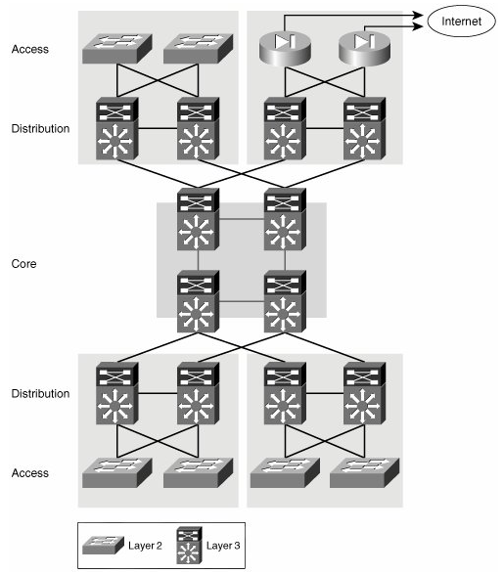
Network Design Rules
Hierarchical approach
Traffic is aggregated hierarchically from an access layer into a layer of distribution switches and finally onto the network core.
A hierarchical approach to network design has proven to deliver the best results in terms of optimizing scalability, improving manageability, and maximizing network availability.

Slide 16
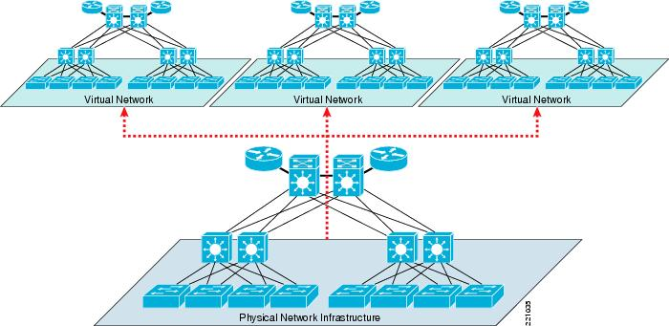
Network Virtualization
What is network virtualization ?

Slide 17
Network Virtualization
What is network virtualization ?
In computing, network virtualization is the process of combining hardware and software network resources and network functionality into a single, software-based administrative entity, a virtual network.
Two categories :
External network virtualization
Combine many networks, or parts of networks, into a virtual unit.
Internal network virtualization
Provide network-like functionality to the software containers on a single system.

Slide 18
Network Virtualization
Desirable properties of network virtualization :
Scalability
Easy to extend resources in need
Administrator can dynamically create or delete virtual network connection
Resilience
Recover from the failures
Virtual network will automatically redirect packets by redundant links
Security
Increased path isolation and user segmentation
Virtual network should work with firewall software
Availability
Access network resource anytime

Slide 19
Network Virtualization
External network virtualization in different layers :
Layer 1
Seldom virtualization implement in this physical data transmission layer.
Layer 2
Use some tags in MAC address packet to provide virtualization.
Example, VLAN.
Layer 3
Use some tunnel techniques to form a virtual network.
Example, VPN.
Layer 4 or higher
Build up some overlay network for some application.
Example, P2P.

Slide 20
Network Virtualization
Internal network virtualization in different layers :
Layer 1
Hypervisor usually do not need to emulate the physical layer.
Layer 2
Implement virtual L2 network devices, such as switch, in hypervisor.
Example, Linux TAP driver + Linux bridge.
Layer 3
Implement virtual L3 network devices, such as router, in hypervisor.
Example, Linux TUN driver + Linux bridge + iptables.
Layer 4 or higher
Layer 4 or higher layers virtualization is usually implemented in guest OS.
Applications should make their own choice.

Slide 21
Network virtualization
Introduction
External network virtualization
Internal network virtualization

Slide 22
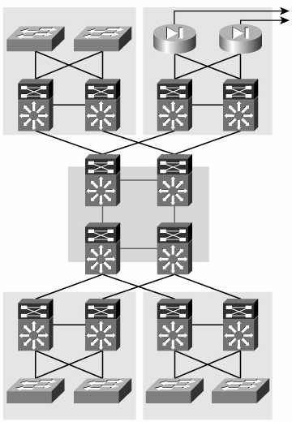
Network Virtualization
Two virtualization components :
Device virtualization
Virtualize physical devices in the network
Data path virtualization
Virtualize communication path between network access points
Data Path
Router
Switch

Slide 23
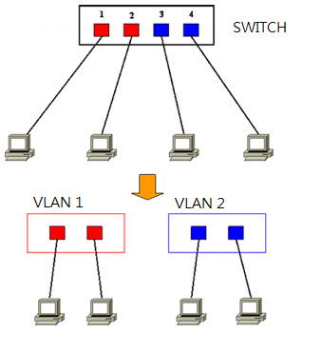
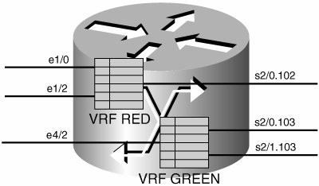
Network Virtualization
Device virtualization
Layer 2 solution
Divide physical switch into multiple logical switches.
Layer 3 solution 3
VRF technique ( Virtual Routing and Forwarding )
Emulate isolated routing tables within one physical router.

Slide 24
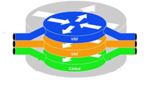

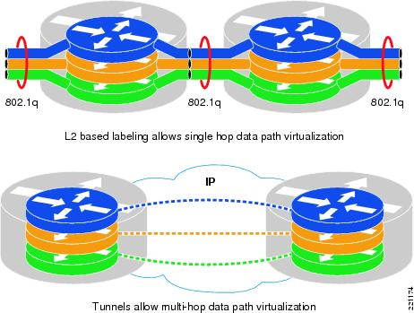
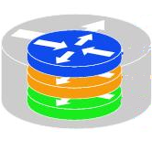
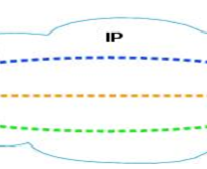
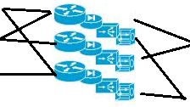
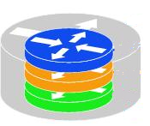
Network Virtualization
Data path virtualization
Hop-to-hop case
Consider the virtualization applied on a single hop data-path.
Hop-to-cloud case
Consider the virtualization tunnels allow multi-hop data-path.

Slide 25
Network Virtualization
Protocol approach
Protocols usually use for data-path virtualization.
Three implementations
802.1Q – implement hop to hop data-path virtualization
MPLS ( Multiprotocol Label Switch ) – implement router and switch layer virtualization
GRE (Generic Routing Encapsulation ) – implement virtualization among wide variety of networks with tunneling technique.

Slide 26

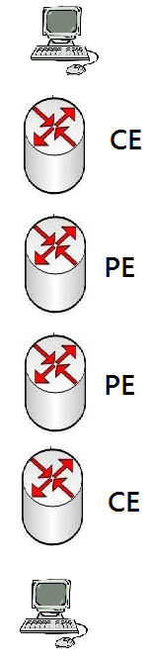

Network Virtualization
802.1Q
Standard by IEEE 802.1
Not encapsulate the original frame
Add a 32-bit field between MAC address and EtherTypes field
ETYPE(2B): Protocol identifier
Dot1Q Tag(2B): VLAN number, Priority code
CE: Customer Edge router
PE: Provider Edge router

Slide 27
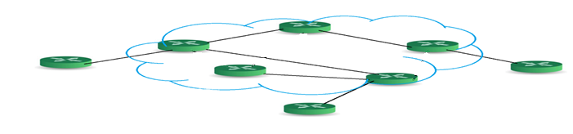

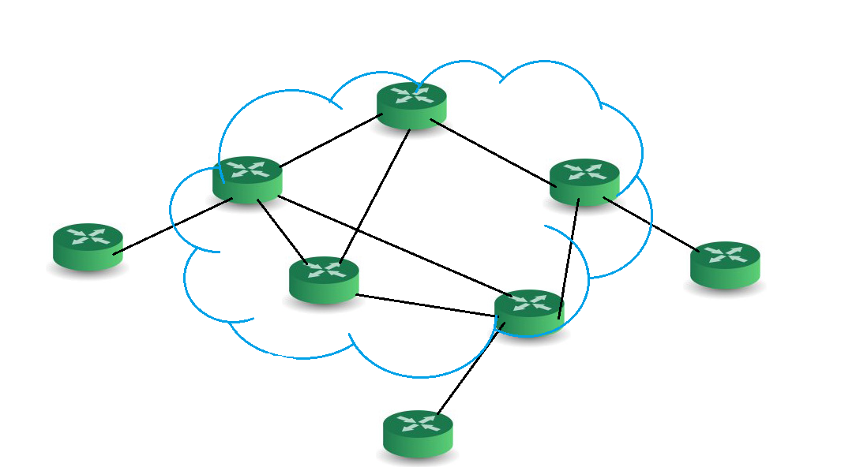
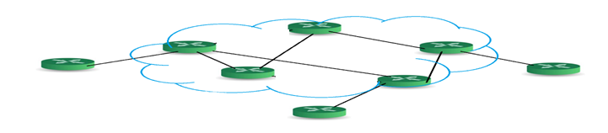
Network Virtualization
Example of 802.1Q
VN 1
Source
destination
Physical Network
VN 2
Source
destination

Slide 28
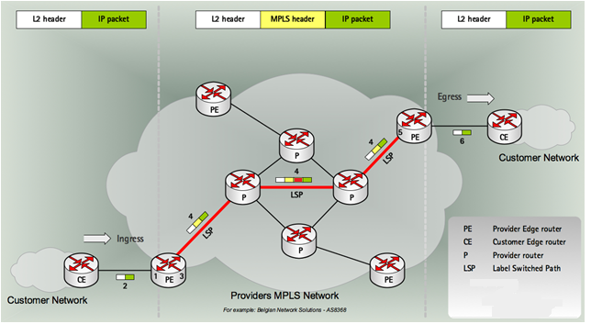
Network Virtualization
MPLS ( Multiprotocol Label Switch )
Also classified as layer 2.5 virtualization
Add one or more labels into package
Need Label Switch Router(LSR) to read MPLS header

Slide 29
Network Virtualization
Example of MPLS
5
4
VN 1
2
7
9
8
LSR
Physical Network
LER
LER
CE
LSR
CE
LER
CE
5
VN 2
4
2
7
9

Slide 30





Network Virtualization
GRE ( Generic Routing Encapsulation )
GRE is a tunnel protocol developed by CISCO
Encapsulate a wide variety of network layer protocols inside virtual point-to-point links over an Internet Protocol internetwork
Stateless property
This means end-point doesn't keep information about the state
Built Tunnel

Slide 31
Network virtualization
Introduction
External network virtualization
Internal network virtualization

Slide 32
Internal Network Virtualization
Internal network virtualization
A single system is configured with containers, such as the Xen domain, combined with hypervisor control programs or pseudo-interfaces such as the VNIC, to create a “network in a box”.
This solution improves overall efficiency of a single system by isolating applications to separate containers and/or pseudo interfaces.
Virtual machine and virtual switch :
The VMs are connected logically to each other so that they can send data to and receive data from each other.
Each virtual network is serviced by a single virtual switch.
A virtual network can be connected to a physical network by associating one or more network adapters (uplink adapters) with the virtual switch.

Slide 33
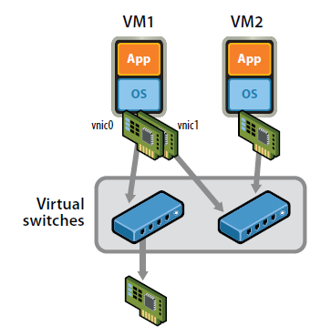
Internal Network Virtualization
Properties of virtual switch
A virtual switch works much like a physical Ethernet switch.
It detects which VMs are logically connected to each of its virtual ports and uses that information to forward traffic to the correct virtual machines.
Typical virtual network configuration
Communication network
Connect VMs on different hosts
Storage network
Connect VMs to remote storage system
Management network
Individual links for system administration

Slide 34
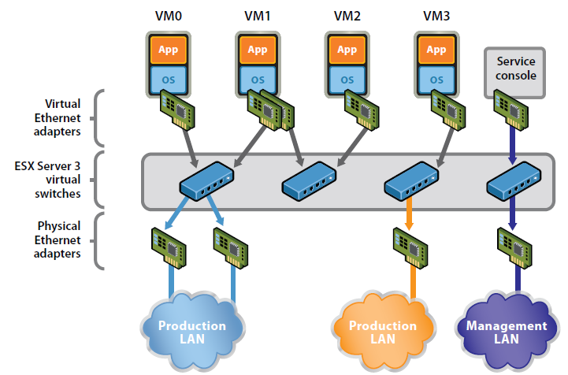
Internal Network Virtualization
Network virtualization example form VMware

Slide 35
KVM Approach
In KVM system
KVM focuses on CPU and memory virtualization, so IO virtualization framework is completed by QEMU.
In QEMU, network interface of virtual machines connect to host by TUN/TAP driver and Linux bridge.
Virtual machines connect to host by a virtual network adapter, which is implemented by TUN/TAP driver.
Virtual adapters will connect to Linux bridges, which play the role of virtual switch.

Slide 36
KVM Approach
TUN/TAP driver
TUN and TAP are virtual network kernel drivers :
TAP (as in network tap) simulates an Ethernet device and operates with layer 2 packets such as Ethernet frames.
TUN (as in network TUNnel) simulates a network layer device and operates with layer 3 packets such as IP.
Data flow of TUN/TAP driver
Packets sent by an operating system via a TUN/TAP device are delivered to a user-space program that attaches itself to the device.
A user-space program may pass packets into a TUN/TAP device. TUN/TAP device delivers (or "injects") these packets to the operating system network stack thus emulating their reception from an external source.

Slide 37
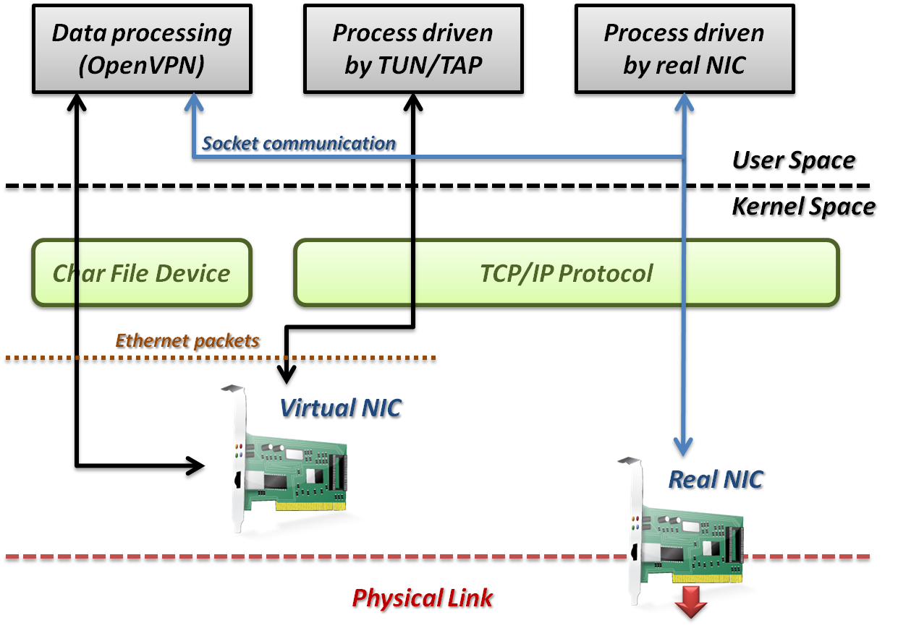
KVM Approach

Slide 38
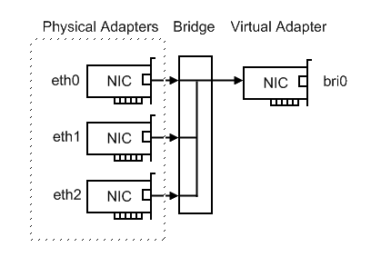
KVM Approach
Linux bridge
Bridging is a forwarding technique used in packet-switched computer networks.
Unlike routing, bridging makes no assumptions about where in a network a particular address is located.
Bridging depends on flooding and examination of source addresses in received packet headers to locate unknown devices.
Bridging connects multiple network segments at the data link layer (Layer 2) of the OSI model.

Slide 39
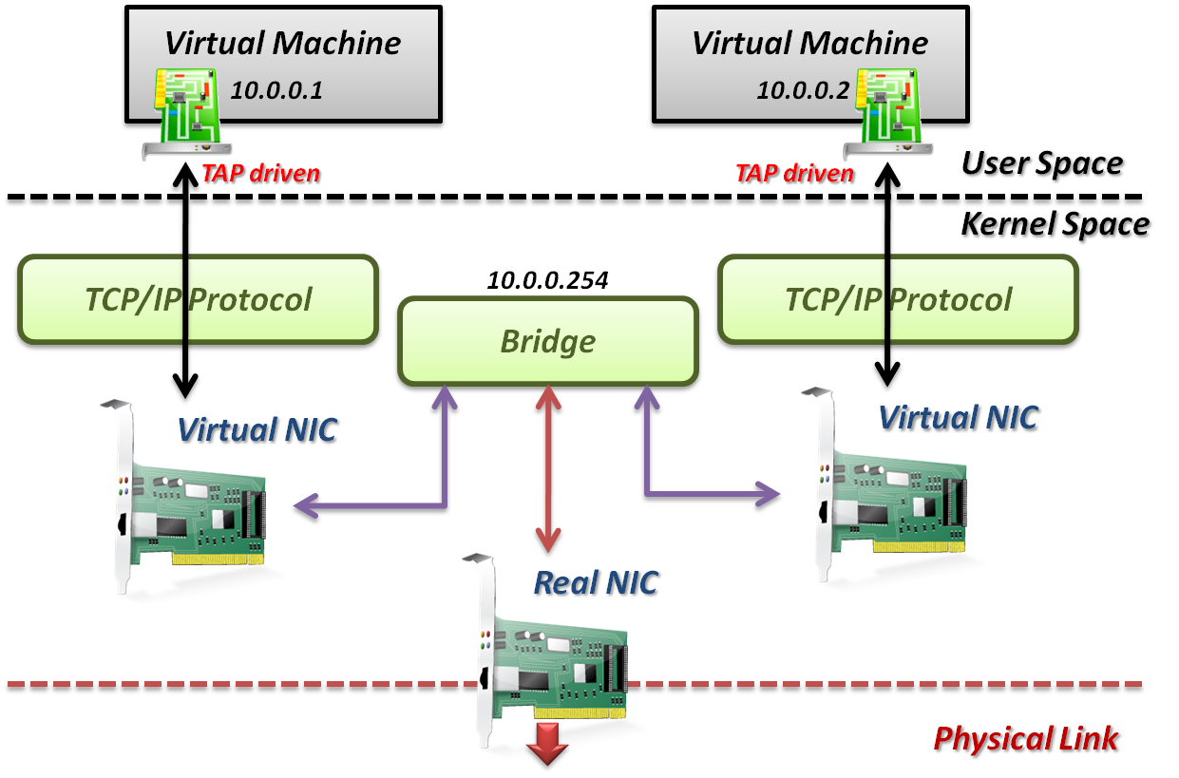
KVM Approach
TAP/TUN driver + Linux Bridge

Slide 40
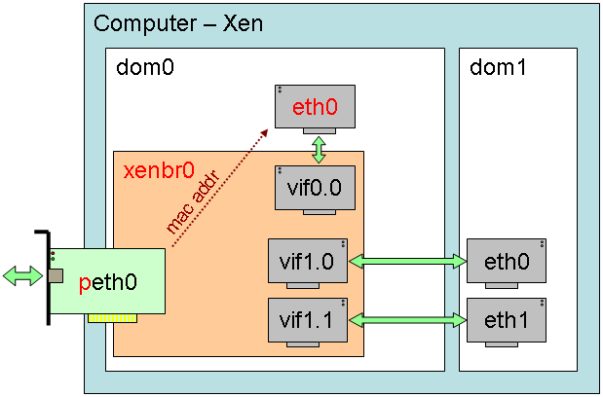
Xen Approach
In Xen system
Since implemented by para-virtualization, guest OS loads modified network interface drivers.
Modified network interface drivers, which act as TAP in KVM approach, communicate with virtual switches in Dom0.
Virtual switch in Xen can be implemented by Linux bridge or work with other approaches.

Slide 41
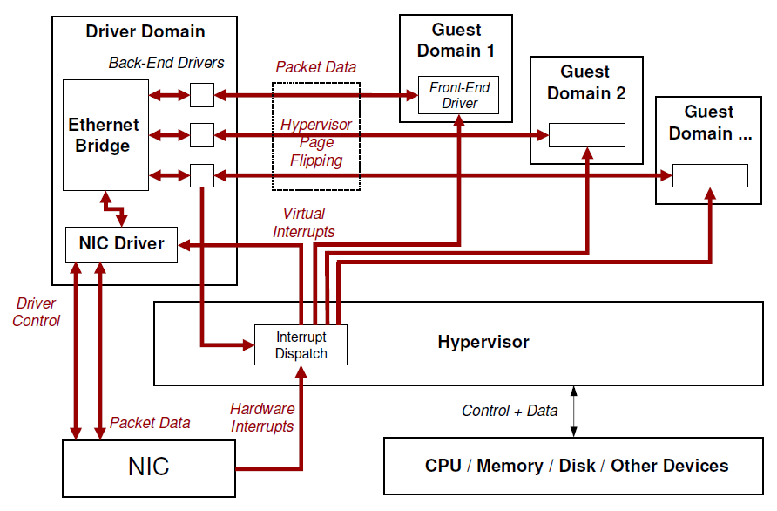
Xen Approach
Detail in Xen System

Slide 42
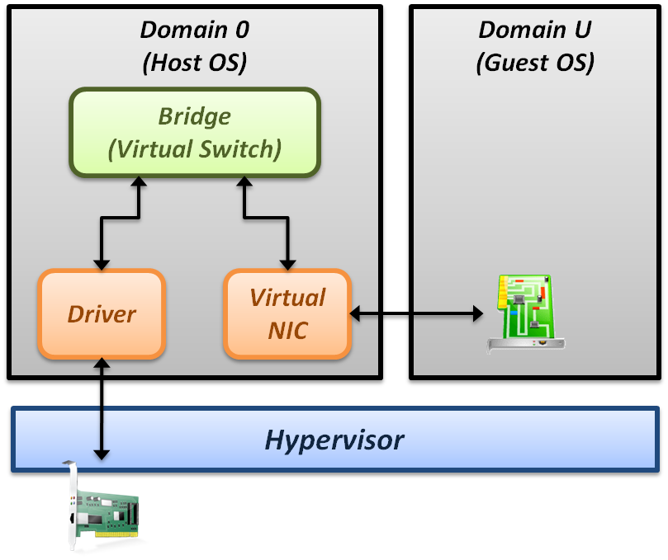
Xen Approach
Some performance issues :
Page remapping
Hypervisor remaps memory page for MMIO.
Context switching
Whenever packets sent, induce one context switch from guest to Domain 0 to drive real NIC.
Software bridge management
Linux bridge is a pure software implementation.
Interrupt handling
When interrupt occur, induce one context switch again.

Slide 43
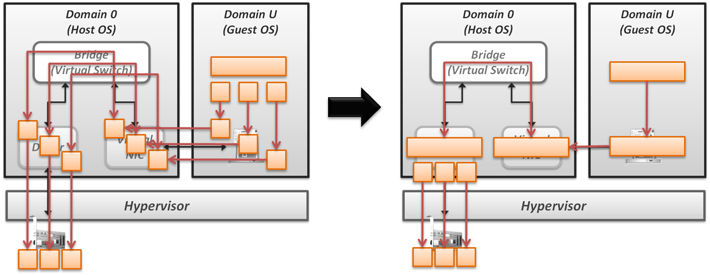
Xen Approach
Improve Xen performance by software
Large effective MTU
Fewer packets
Lower per-byte cost

Slide 44
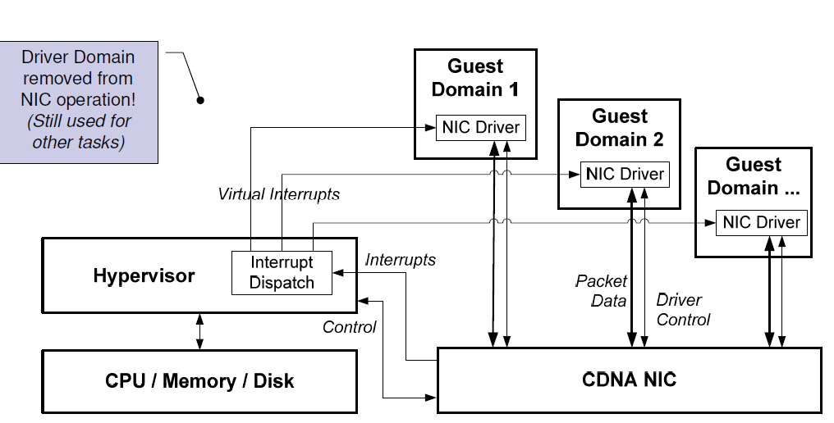
Xen Approach
Improve Xen performance by hardware
CDNA (Concurrent Direct Network Access) hardware adapter
Remove driver domain from data and interrupts
Hypervisor only responsible for virtual interrupts and assigning context to guest OS

Slide 45
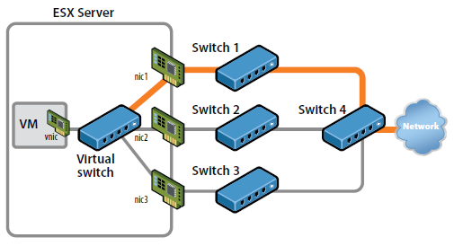
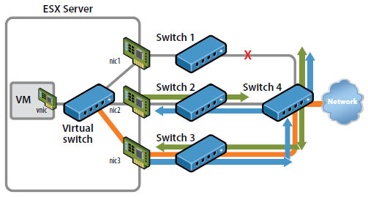
Case Study
VMware offer a hybrid solution of network virtualization in Cloud.
Use redundant links to provide high availability.
Virtual switch in host OS will automatically detect link failure and redirect packets to back-up links.

Slide 46
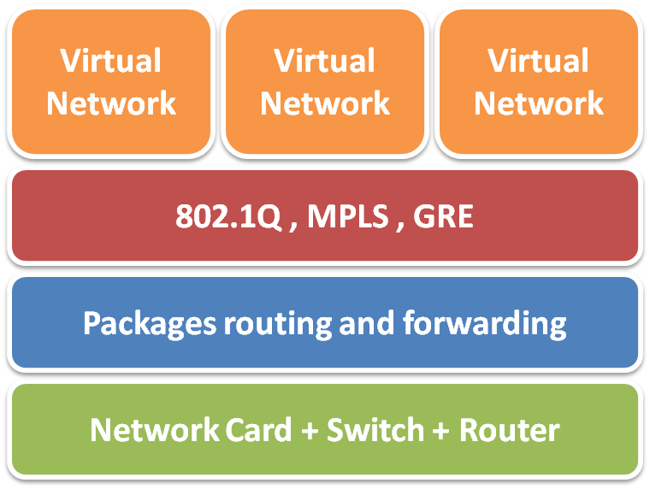
Network Virtualization Summary
Virtualization in layers
Usually in Layer 2 and Layer 3
External network virtualization
Layer 2
802.1q
Layer 3
MPLS, GRE
Internal network virtualization
Traditional approach
TAP/TUN + Linux bridge
New technique
Virtual switch

Slide 47
Reference
Books :
Kumar Reddy & Victor Moreno, Network Virtualization, Cisco Press 2006
Web resources :
Linux Bridge http://www.ibm.com/developerworks/cn/linux/l-tuntap/index.html
Xen networking http://wiki.xensource.com/xenwiki/XenNetworking
VMware Virtual Networking Concepts http://www.vmware.com/files/pdf/virtual_networking_concepts.pdf
TUN/TAP wiki http://en.wikipedia.org/wiki/TUN/TAP
Network Virtualization wiki http://en.wikipedia.org/wiki/Network_virtualization
Papers :
A. Menon, A. Cox, and W. Zwaenepoel. Optimizing Network Virtualization in Xen. Proc. USENIX Annual Technical Conference (USENIX 2006), pages 15–28, 2006.

